Slide 1
How to use the Break Indicator in the physical item together with summary holdings
Yoel Kortick
Senior Librarian

Slide 2
Agenda
Introduction
Our sample record before using the Break Indicator
Our sample record after using the Break Indicator
2

Slide 3
Introduction

Slide 4
Introduction
This presentation assumes that the audience is already familiar with the summary holdings functionality in Alma.
We will focus here not on the entire process of creating summary holdings, but rather specifically on how the Break Indicator in the physical item can be used to influence the creation and appearance of the summary holdings
For more information on the summary holdings in general see:
  Serials Prediction Patterns and Serial Check-in.pptx
  Serials Automation tasks for summary holdings.pptx
  How to create predicted items without a POL (acquisitions order)

Slide 5
Introduction
The break indicator is used in the physical item to indicate (as the name suggests) that there is a “break” in the continuity of the item enumeration and chronology (also known as a “gap”).
This is needed when summary holdings are being built but the missing issues are not entered into Alma with both
  A link to the 853/4/5 field of the holdings record
  A lack of a receiving date
When there are no items entered into Alma without the receiving date, there is no way for the summary holdings process to know where there is a gap.
The Break Indicator tells the summary holdings process where the gap is.

Slide 6
Our sample record before using the Break Indicator

Slide 7
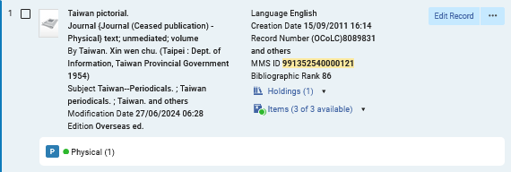
Our sample record before using the Break Indicator
We have bibliographic record MMSID 991352540000121 title “Taiwan pictorial.”

Slide 8
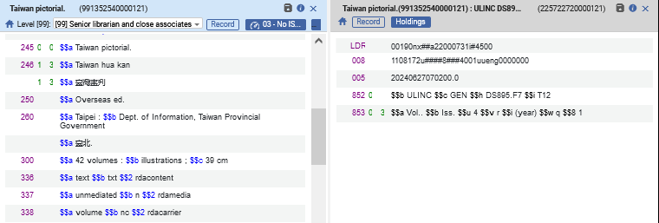
Our sample record before using the Break Indicator
We have a holdings record connected to the bibliographic record and it has an 853 field for a quarterly journal, with subfield 8 (Field link and sequence number) “1”
853 field for a quarterly journal, with subfield 8 (Field link and sequence number) “1”

Slide 9
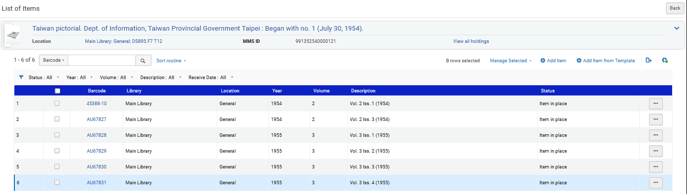
Our sample record before using the Break Indicator
This journal has 6 issues:
We are missing:
Vol. 2 Iss. 2 (1954)
Vol. 2 Iss. 4 (1954)
We have all of Vol. 3

Slide 10
Our sample record before using the Break Indicator
The six items have the following values
Enum A | Enum B | Chron I | Description | Pattern type | Linking Number | Receiving Date
2 | 1 | 1954 | Vol. 2 Iss. 1 (1954) | 3 (853) | 1 | 27/06/2024
2 | 3 | 1954 | Vol. 2 Iss. 3 (1954) | 3 (853) | 1 | 27/06/2024
3 | 1 | 1955 | Vol. 3 Iss. 1 (1955) | 3 (853) | 1 | 27/06/2024
3 | 2 | 1955 | Vol. 3 Iss. 2 (1955) | 3 (853) | 1 | 27/06/2024
3 | 3 | 1955 | Vol. 3 Iss. 3 (1955) | 3 (853) | 1 | 27/06/2024
3 | 4 | 1955 | Vol. 3 Iss. 4 (1955) | 3 (853) | 1 | 27/06/2024

Slide 11
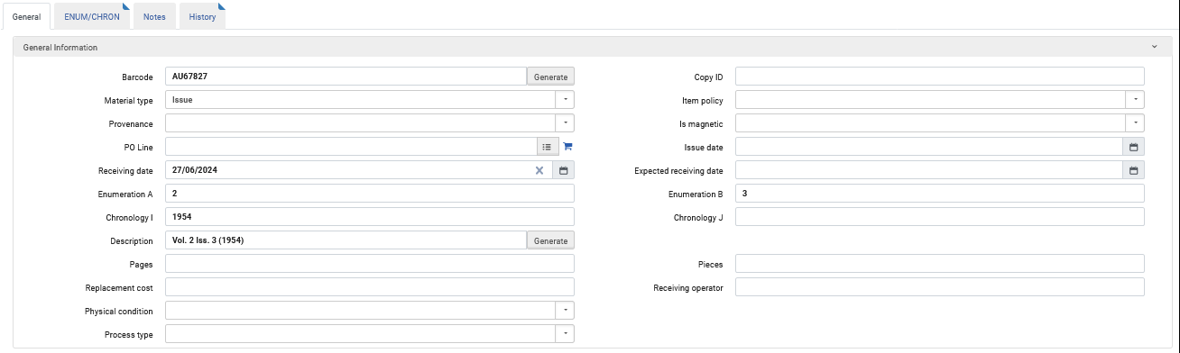
Our sample record before using the Break Indicator
For example, here is Vol. 2 Iss. 3 (1954) – screenshot 1 of 2
A receiving date is necessary for the summary holdings

Slide 12
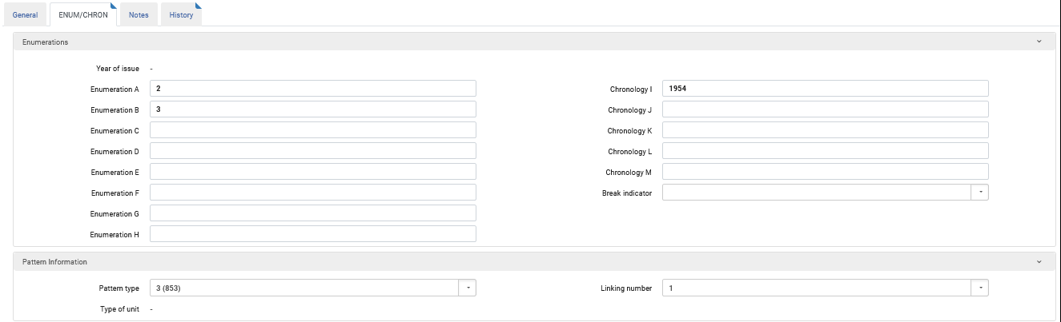
Our sample record before using the Break Indicator
For example, here is Vol. 2 Iss. 3 (1954) – screenshot 2 of 2
This links the item to the 853 field of the holdings record

Slide 13
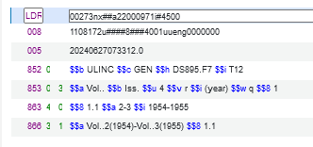
Our sample record before using the Break Indicator
Here is the summary holdings record with 863 and 866 fields automatically created.
The 863 and the 866 fields state that we have Vol. 2 from 1954 and Vol. 3 from 1955.
There is no specific indication here that we are missing:
Vol. 2 Iss. 2 (1954)
Vol. 2 Iss. 4 (1954)

Slide 14
Our sample record after using the Break Indicator

Slide 15
Our sample record after using the Break Indicator
Now in these two items:
  Vol. 2 Iss. 1 (1954)
  Vol. 2 Iss. 3 (1954)
We will add a break indicator with “G (Gap)” to indicate that there is a gap after the issue.
  After Iss. 1 we are missing Iss. 2
  After Iss. 3 we are missing Iss. 4

Slide 16
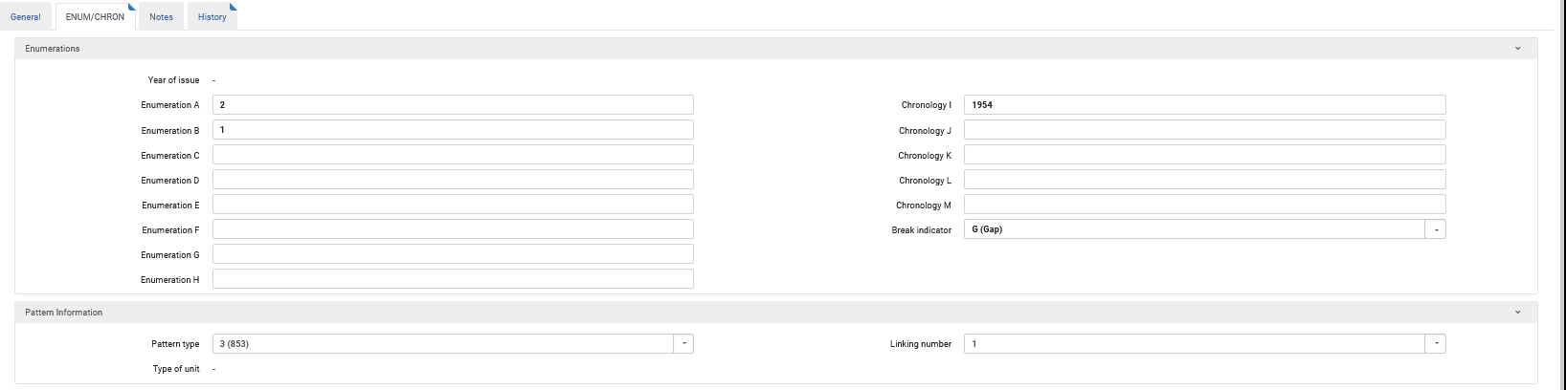
Our sample record after using the Break Indicator
Vol. 2 Iss. 1 (1954)
Vol. 2 Iss. 1 (1954)
a break indicator with “G (Gap)”

Slide 17
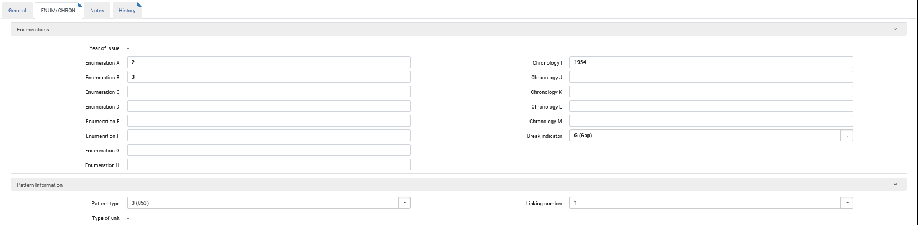
Our sample record after using the Break Indicator
Vol. 2 Iss. 3 (1954)
Vol. 2 Iss. 3 (1954)
a break indicator with “G (Gap)”

Slide 18
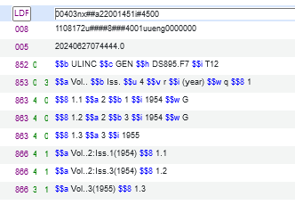
Our sample record after using the Break Indicator
Here is the summary holdings record with 863 and 866 fields automatically created when we are using the Break Indicator.
The 863 and the 866 fields state that we have Vol. 2 from 1954 and Vol. 3 from 1955, and also reflect the gap (subfield w with value “G”).
In the 863 fields we clearly see that we have
Vol. 2 Issue 1 from 1954 then a gap
Vol. 2 Issue 3 from 1954 then a gap
All of Vol. 3 from 1955
In the 866 fields we clearly see that we have
Vol. 2 Issue 1 from 1954
Vol. 2 Issue 3 from 1954
All of Vol. 3 from 1955

Slide 19
Our sample record after using the Break Indicator
Without the Break Indicator | With the Break Indicator

Slide 20
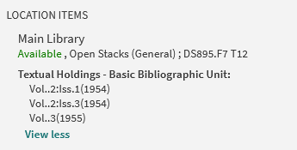
Our sample record after using the Break Indicator
In Discovery the end user gets a clear indication of the contents of the holdings

Slide 21
Thank You

